Slide 1
Node Addition and Removal

Slide 2
Objectives
After completing this lesson, you should be able to:
  Add a new node to your cluster database
  Remove a node from your cluster database
Notes:
Oracle Database 11g: RAC Administration 11 - <number>

Slide 3
Add and Delete Nodes and Instances: Overview
Three main methods:
  Silent cloning procedures
  Enterprise Manager Grid Control cloning and adding instance
  addNode.sh/rootdeletenode.sh and DBCA
Notes:
Add and Delete Nodes and Instances: Overview
This lesson describes how to add and delete nodes and instances in Oracle Real Application Clusters (RAC) databases. There are mainly three methods you can use to add and delete nodes in a RAC environment:
Silent cloning procedures. Cloning enables you to copy images of Oracle Clusterware and RAC software onto the other nodes that have identical hardware and software.
Enterprise Manager Grid Control. This is basically a GUI interface to cloning procedures.
Interactive or silent procedures using addNode.sh/rootdeletenode.sh and the Database Configuration Assistant (DBCA)
The preferred method to add multiple nodes and instances to RAC databases is to use the cloning procedures. This is especially relevant when you are massively deploying software across your enterprise. Refer to the Oracle Real Application Clusters Administration and Deployment Guide as well as the Oracle Clusterware Administration and Deployment Guide for more information about cloning procedures.
However, in this lesson you are going to see how you can directly use Oracle Universal Installer (OUI) and DBCA to add one node to and delete one node from your cluster.

Slide 4
Main Steps to Add a Node to a RAC Cluster
  Install and configure OS and hardware for new node.
  Add Oracle Clusterware to the new node.
  Configure ONS for the new node.
  Add ASM home to the new node.
  Add RAC home to the new node.
  Add a listener to the new node.
  Add a database instance to the new node.
[
]
ORACLE_HOME
ORACLE_HOME
CRS HOME
CRS HOME
Storage
Notes:
Main Steps to Add a Node to a RAC Cluster
The slide lists the main steps you need to follow to add a new node to your RAC cluster. Basically, you are going to use OUI to copy the Oracle Clusterware software as well as the RAC software to the new node. For each main step, you have to do some manual configurations.
Note: For all the add node and delete node procedures for UNIX-based systems, temporary directories such as /tmp, $TEMP, or $TMP should not be shared directories. If your temporary directories are shared, set your temporary environment variable, such as $TEMP, to a nonshared location on a local node. In addition, use a directory that exists on all the nodes.

Slide 5
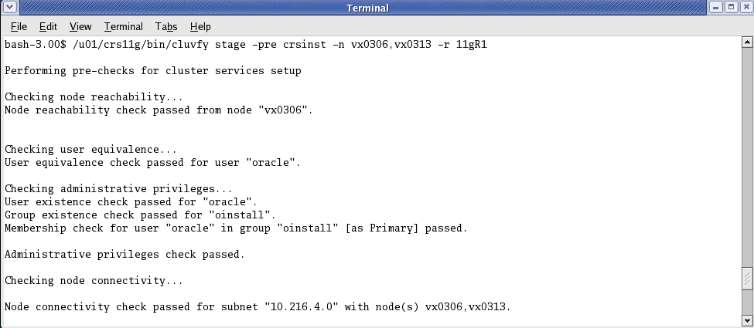
Check Prerequisites Before
Oracle Clusterware Installation
Notes:
Check Prerequisites Before Oracle Clusterware Installation
Before you can proceed with the Oracle Clusterware installation on the node you want to add to your RAC cluster, you must make sure that all operating system and hardware prerequisites are met. Because installation and configuration of your operating system is not the scope of this lesson, refer to the first lessons of this course for more information.
After this is done, you can verify that the system has been configured properly for Oracle Clusterware by using the following Cluster Verify command from one of the nodes that is already part of your cluster: \
cluvfy stage -pre crsinst -n <list of all nodes> -r 11gR1
The example shown in the slide assumes that you have only one node currently as part of your cluster, and you want to add a new one called VX0313. If any errors are reported during the preceding verification, fix them before proceeding to the next step.

Slide 6
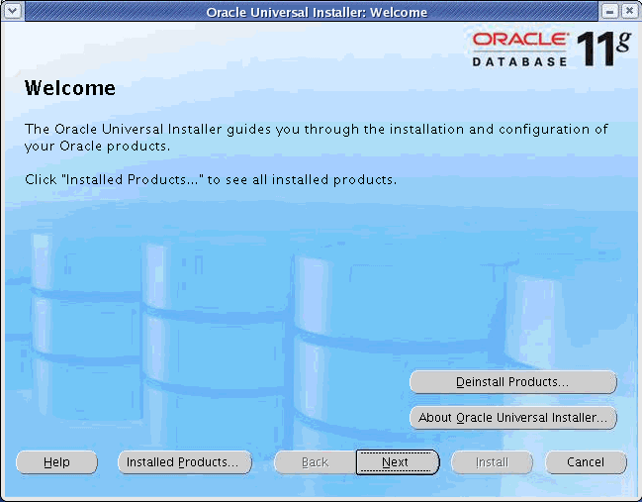
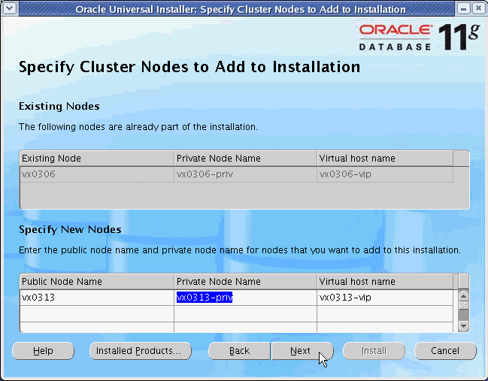
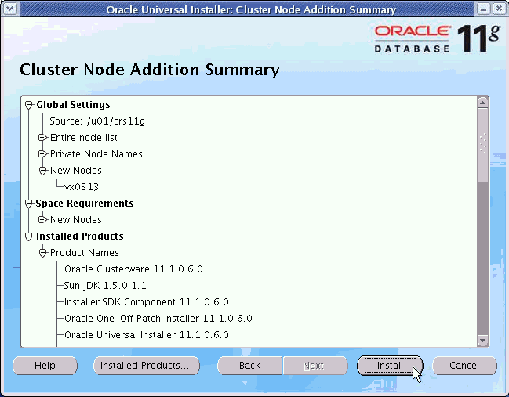
Add Oracle Clusterware to the New Node
Execute <Oracle Clusterware home>/oui/bin/addNode.sh.
Notes:
Add Oracle Clusterware to the New Node
Log in as the oracle user and execute the addNode.sh script located in your Oracle Clusterware home directory on the first node. This script runs the Oracle Universal Installer.
On the Welcome screen, click Next.
On the Specify Cluster Nodes to Add to Installation screen, OUI recognizes the existing nodes and asks you to enter the “short” public node name of the host you want to add to your cluster. That should automatically populate the corresponding Private Node Name and “Virtual host name” fields. Make sure that those three names are correct and click Next.
You next see the Cluster Node Addition Summary screen, where you can review the list of products to be installed. Click Install.
Note: It is also possible to execute OUI in silent mode. Here is a possible example where you want to add a new node called newnode:
addNode.sh -silent -responseFile myinstallresponsefile
Here, myinstallresponsefile contains the following:
CLUSTER_NEW_NODES = {"newnode"}
CLUSTER_NEW_PRIVATE_NODE_NAMES = {"newnode-priv"} CLUSTER_NEW_VIRTUAL_HOSTNAMES = {"newnode-vip"}

Slide 7
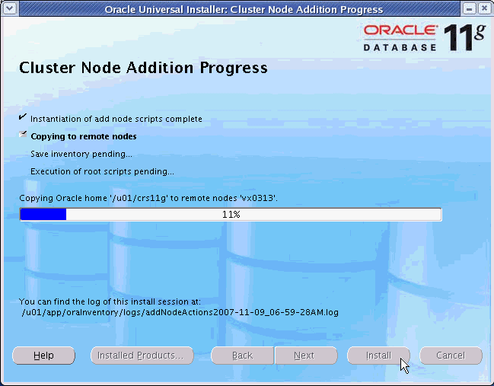
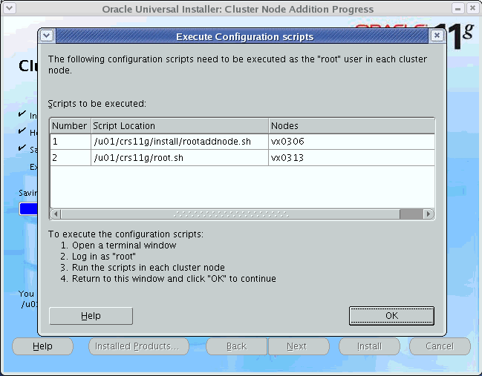
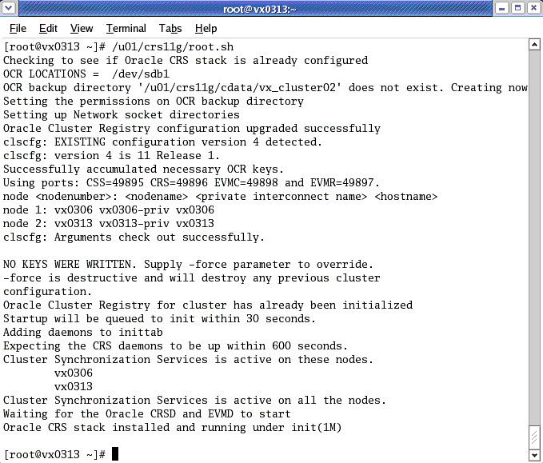
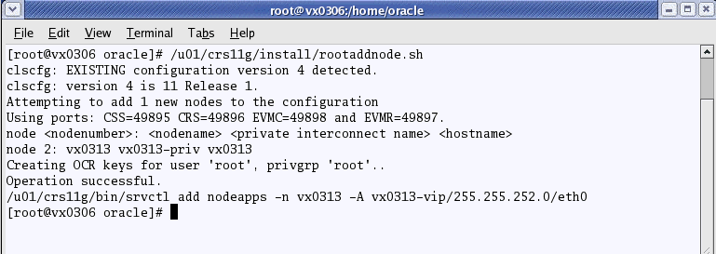
Add Oracle Clusterware to the New Node
Notes:
Add Oracle Clusterware to the New Node (continued)
You can now follow the installation progression from the Cluster Node Addition Progress screen.
The OUI copies the Oracle Clusterware software to the new node, and then asks you to run few scripts as the root user on both nodes. Make sure that you run the scripts on the correct node as specified one after another.
You have to execute the rootaddnode.sh script on the first node. Basically, this script adds the nodeapps of the new node to the OCR configuration.
After this is done, you have to execute the root.sh script from the new node. This script starts the Oracle Clusterware stack on the new node and then uses VIPCA (Virtual IP Configuration Assistant) in silent mode for configuring nodeapps.

Slide 8
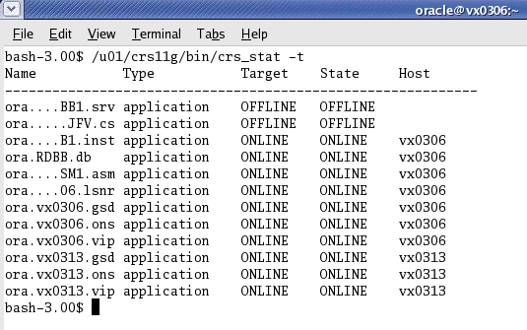

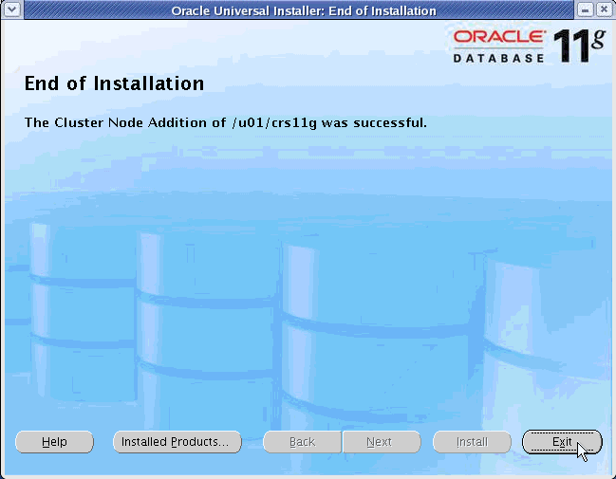
Add Oracle Clusterware to the New Node
Notes:
Add Oracle Clusterware to the New Node (continued)
After both scripts are executed successfully, you can check your Oracle Cluster Registry (OCR) configuration as shown in the slide. At this point, the crs_stat command reports three new resources on the new node. These resources correspond to nodeapps.
Click OK on the Execute Configuration scripts screen to reach the end of the Oracle Clusterware installation.
On the End of Installation screen, click Exit.

Slide 9
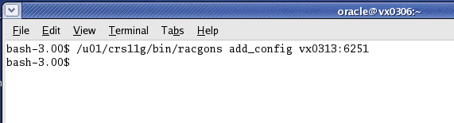
Configure the New ONS
Use the racgons add_config command to add new node ONS configuration information to OCR.
Notes:
Configure the New ONS
You now need to add the new node ONS (Oracle Notification Server) configuration information to the shared ONS configuration information stored in OCR. From the first node, and looking at the ons.config file located in the <Oracle Clusterware home>/opmn/conf directory, you can determine the ONS remote port to be used (6251 in the slide). You need to use this port in the racgons add_config command as shown in the slide to make sure that the ONS on the first node can communicate with the ONS on the new node.

Slide 10
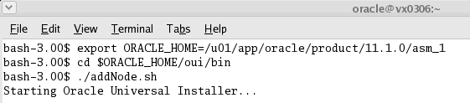
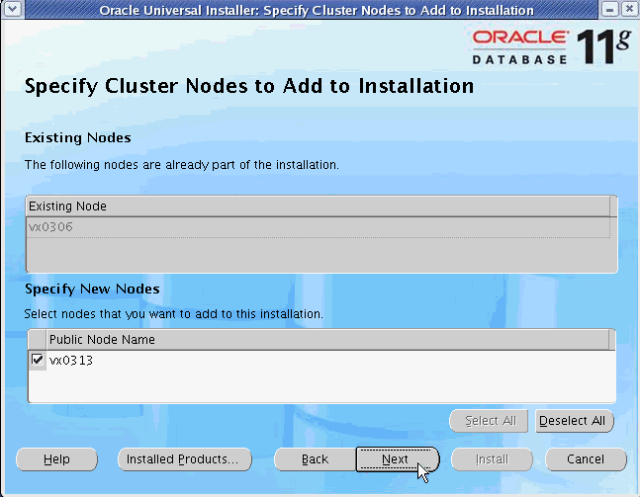

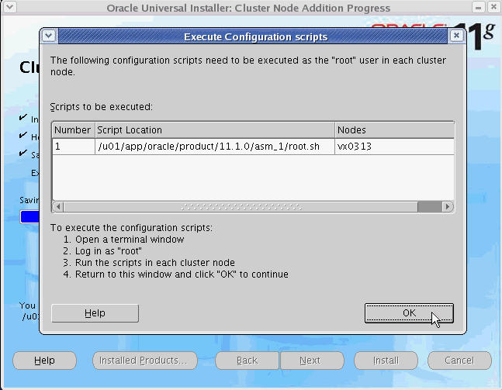
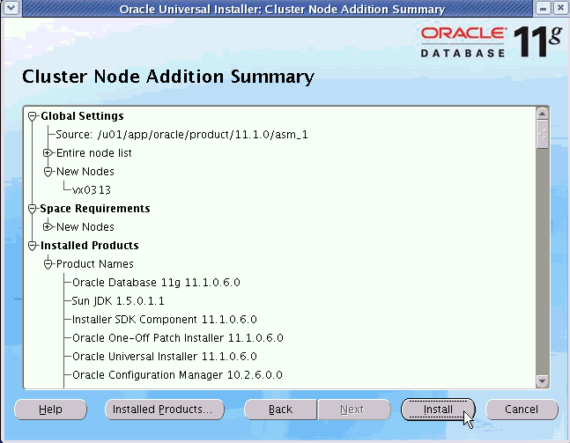
Add ASM Home to the New Node
Notes:
Add ASM Home to the New Node
This step is needed only if you use a specific home directory to host ASM. If you run ASM and your RAC database out of the same Oracle Home, you can skip this step.
From the first node, you need to execute the addNode.sh script from the ASM home directory as shown in the slide. The scenario is identical to the one shown for the Oracle Clusterware installation. However, in the case of an Oracle Home, you just need to select the name of the node you want to add on the Specify Cluster Nodes to Add to Installation screen, and then run the root.sh script from the new node after OUI has copied the database software.

Slide 11
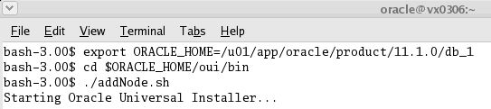
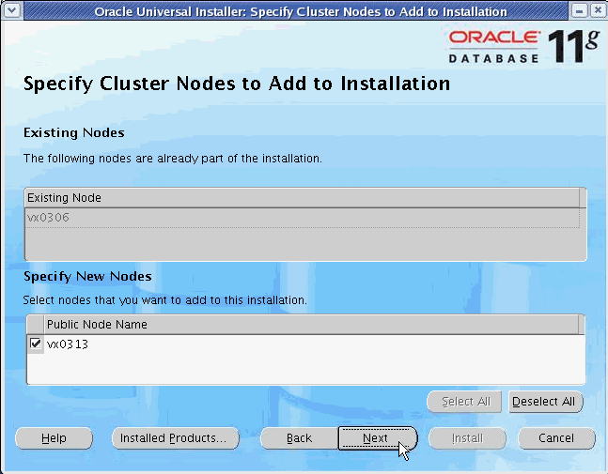

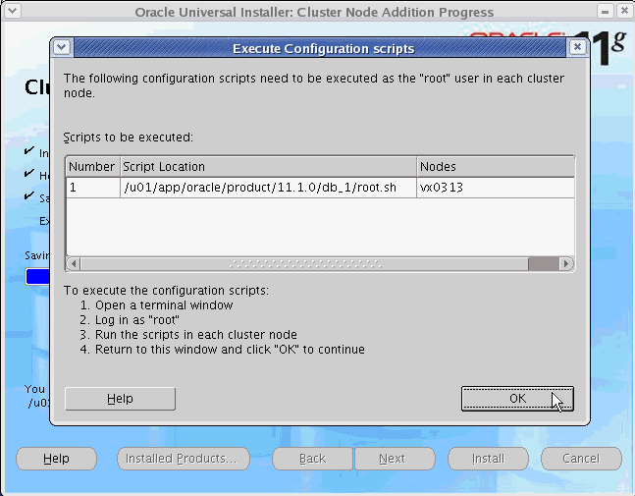
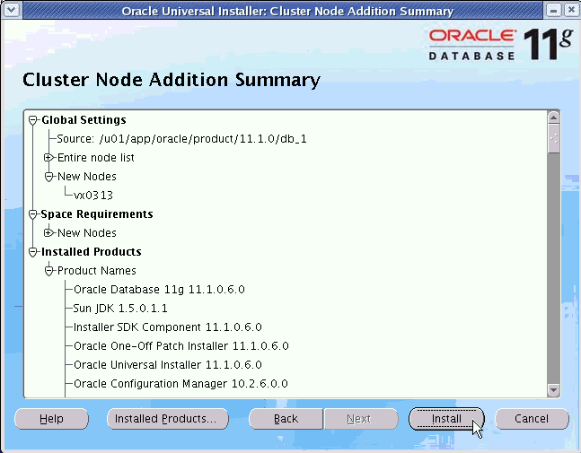
Add RAC Home to the New Node
Notes:
Add RAC Home to the New Node
From the first node, you need to execute the addNode.sh script from the RAC home directory as shown in the slide. The scenario is identical to the one shown for the ASM home installation.

Slide 12
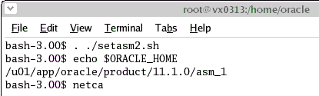
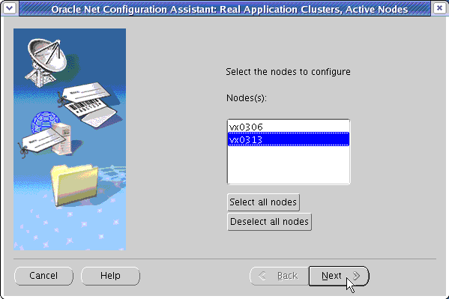
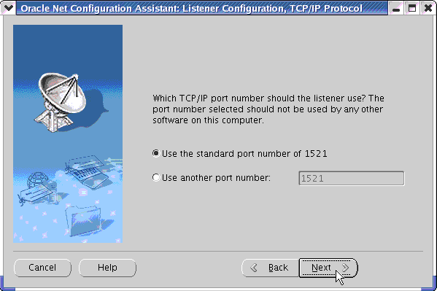
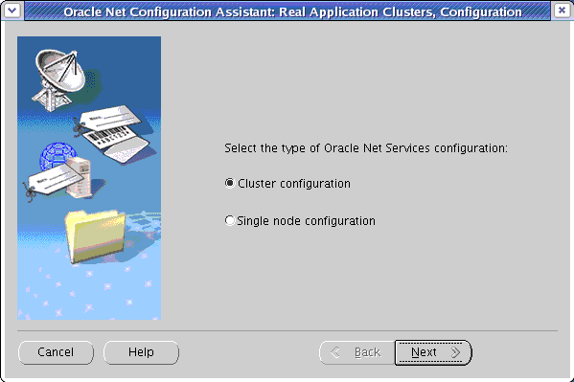
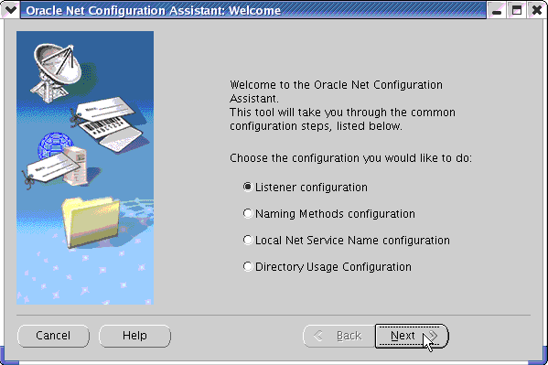
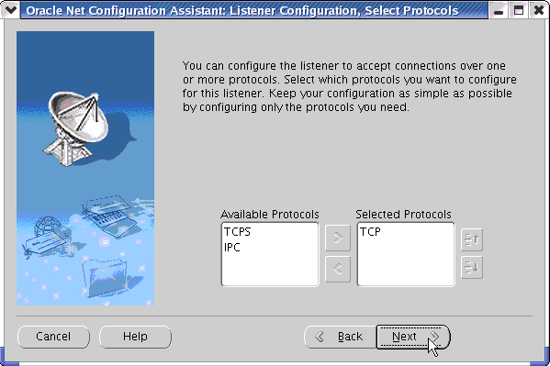
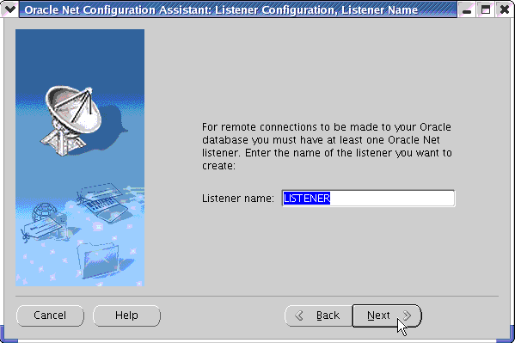
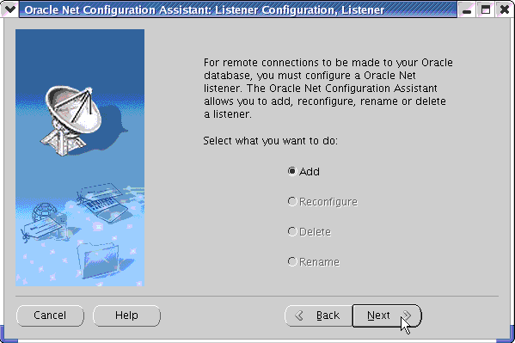
Add a Listener to the New Node
Notes:
Add a Listener to the New Node
From the new node, you need to add a listener. In this example, you are adding a listener from the ASM Home. You need to use NETCA (NETwork Configuration Assistant) for that.
On the Configuration screen, select “Cluster configuration” and click Next.
On the Active Nodes screen, select the name of the new node and click Next.
On the Welcome screen, select “Listener configuration” and click Next.
On the Listener screen, select Add and click Next.
One the Listener Name screen, enter LISTENER in the “Listener name” field.
On the Select Protocols screen, select TCP and click Next.
On the TCP/IP Protocol screen, select “Use the standard port number of 1521,” and click Next.
Continue to click Next until you exit from NETCA.
The steps above add a listener on the new node with the name LISTENER_<New node name>.

Slide 13
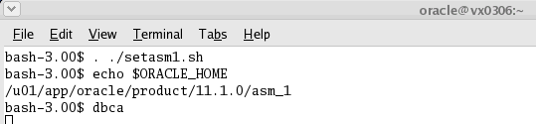
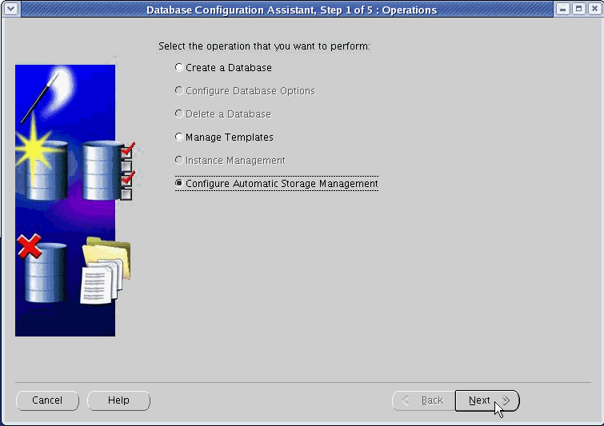
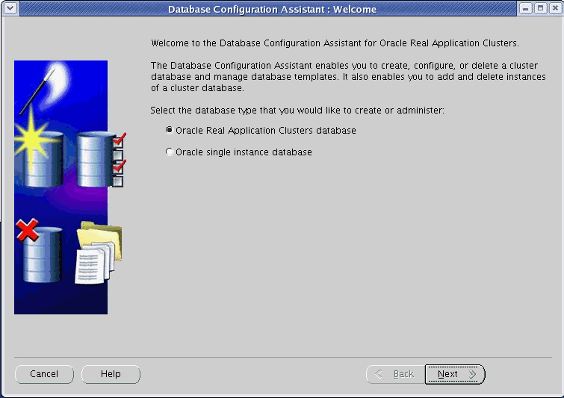
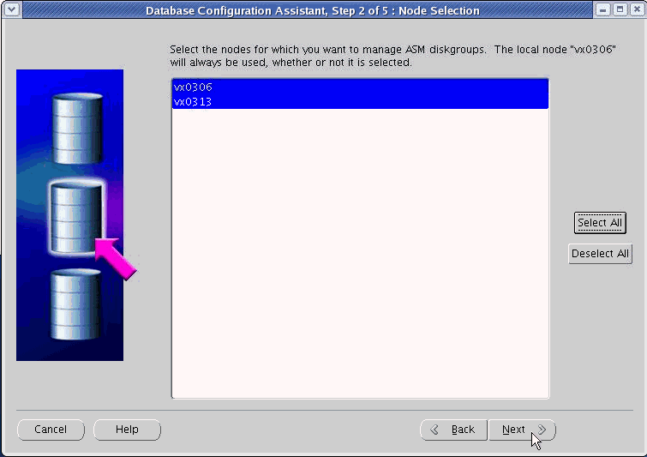
Add an ASM Instance to the New Node
Notes:
Add an ASM Instance to the New Node
Before you can add your database instance to the new node, you need to add an ASM instance to the new node. To do so, use DBCA from your ASM home as shown on the above slide.
On the Welcome screen, click Next.
On the Operations screen, select Configure Automatic Storage Management and click Next.
On the Node Selection screen, select the node you want to add, and click Next.
Note: By default if your ASM instance is running out of the same oracle home, then DBCA automatically extends ASM to the new node when you use DBCA to extend your database instance to the new node.

Slide 14
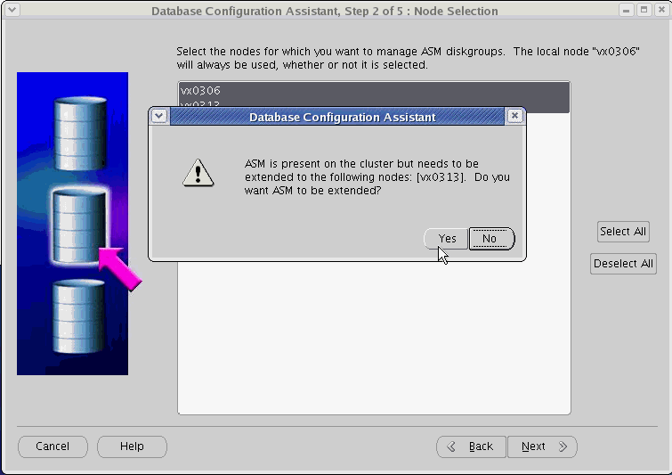
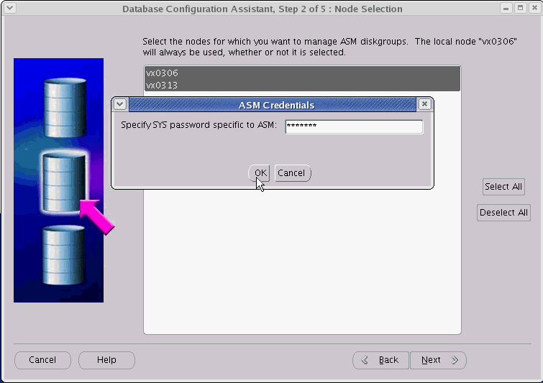
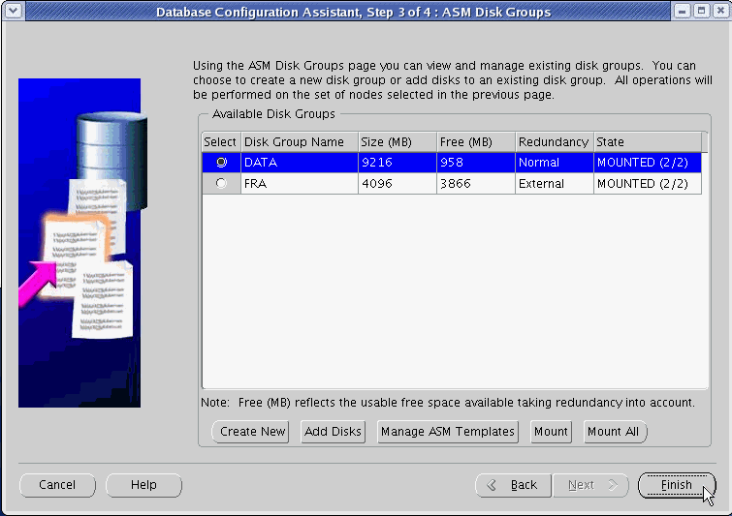
Add an ASM Instance to the New Node
Notes:
Add an ASM Instance to the New Node (continued)
After a while, DBCA prompts you for ASM instance addition on your second node. Click Yes.
DBCA then asks you to enter the password for the ASM administrator. Enter your password and click OK.
On the ASM Disk Groups screen, you should see all your disk groups mounted on all nodes of your cluster.
Click Finish.

Slide 15
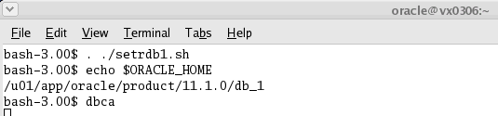
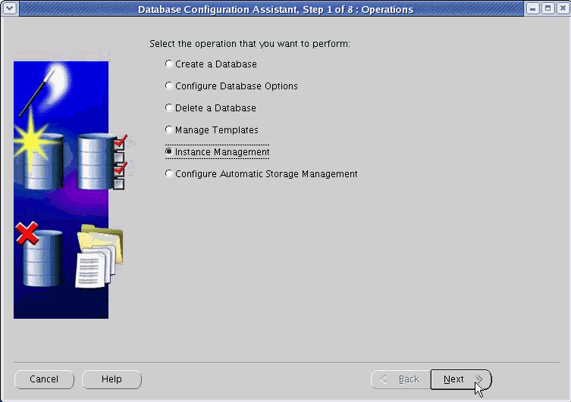
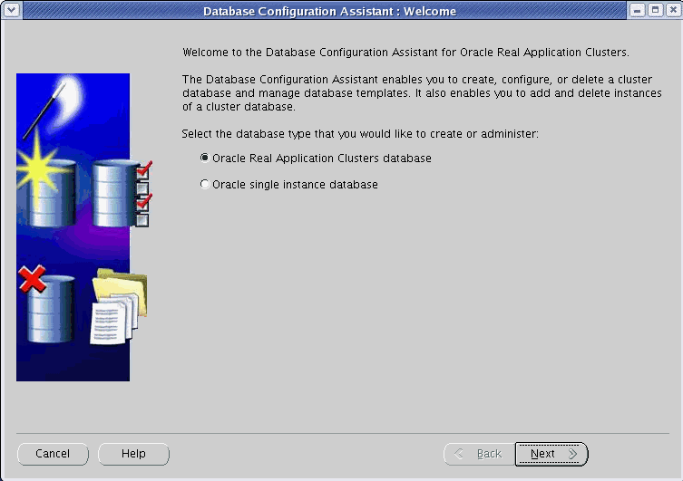
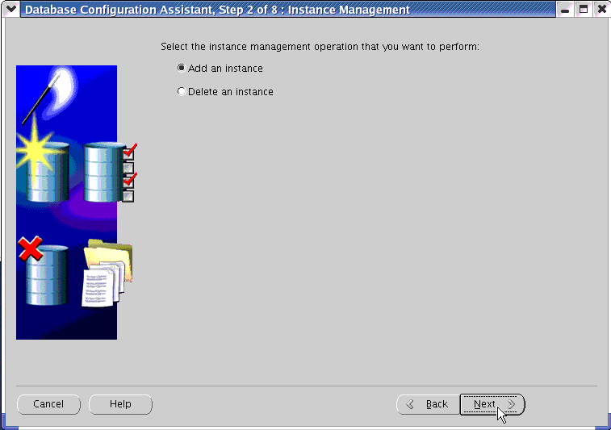
Add a Database Instance to the New Node
Notes:
Add a Database Instance to the New Node
You now need to add a database instance to your RAC database. You can do so by using the DBCA from the first node.
On the Welcome screen, select “Oracle Real Application Clusters database” and click Next.
On the Operations screen, select Instance Management and click Next.
On the Instance Management screen, select “Add an instance” and click Next.

Slide 16
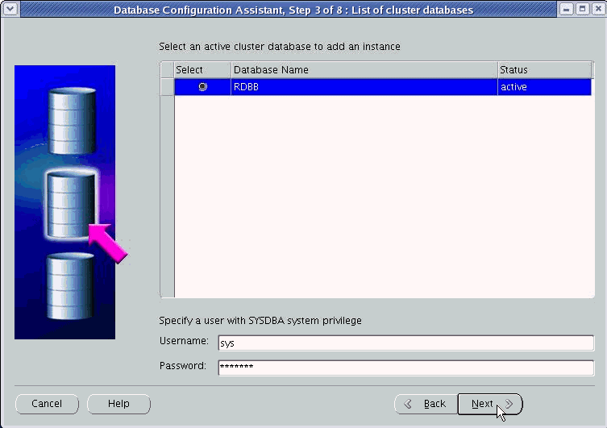
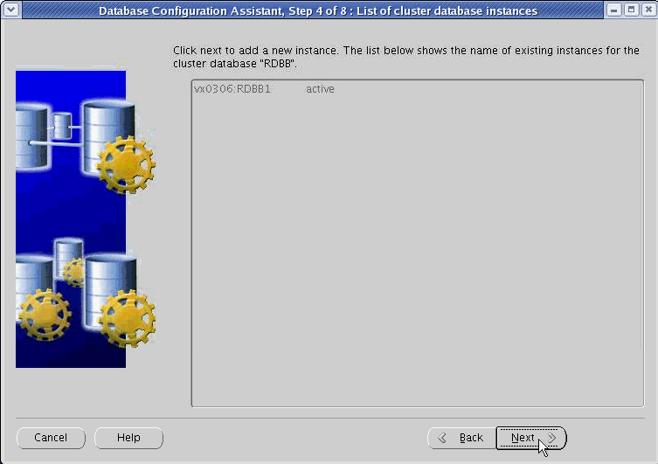
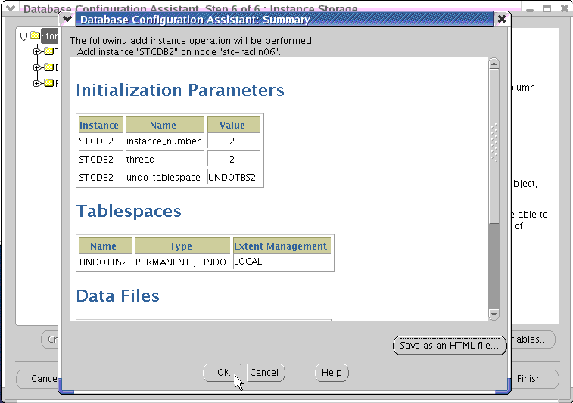
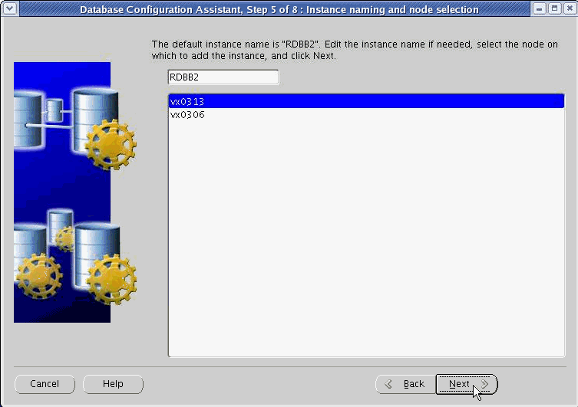
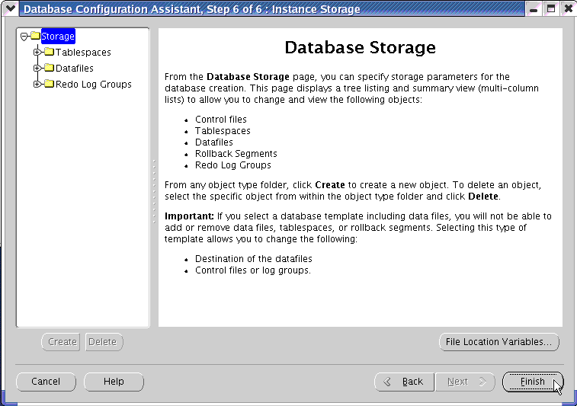
Add a Database Instance to the New Node
Notes:
Add a Database Instance to the New Node (continued)
On the “List of cluster databases” screen, select your RAC database and enter SYS credentials. Then, click Next.
On the “List of cluster database instances” screen, click Next.
On the “Instance naming and node selection” screen, select the node name on which you want to add the instance, and specify the name of that instance. When done, click Next.
On the Instance Storage screen, click Finish.
On the Summary screen, check the various parameters and click OK.

Slide 17
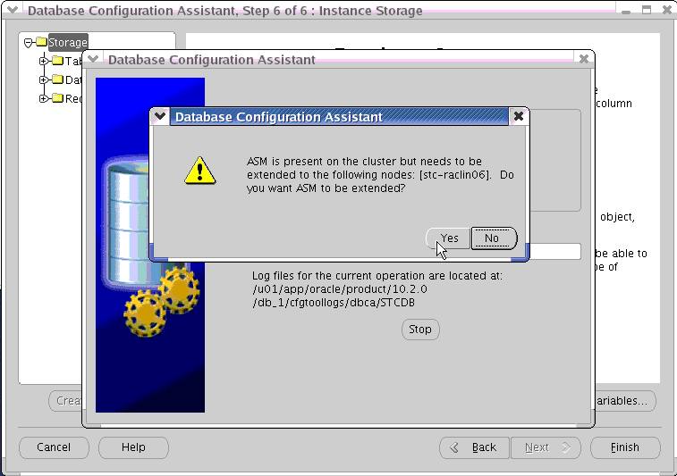
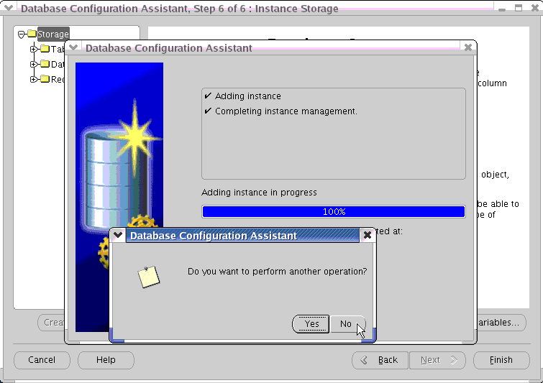
Add a Database Instance to the New Node
Notes:
Add a Database Instance to the New Node (continued)
At this point, if you are using ASM for your database storage, and there is currently no running ASM instance on your new node, DBCA detects the need for an ASM instance creation on the new node. This must be done before the DBCA can create the database instance on that node. Click Yes.
The assistant is now adding your instance to your RAC database on the new node. It will also start that instance at the end of the operation.

Slide 18
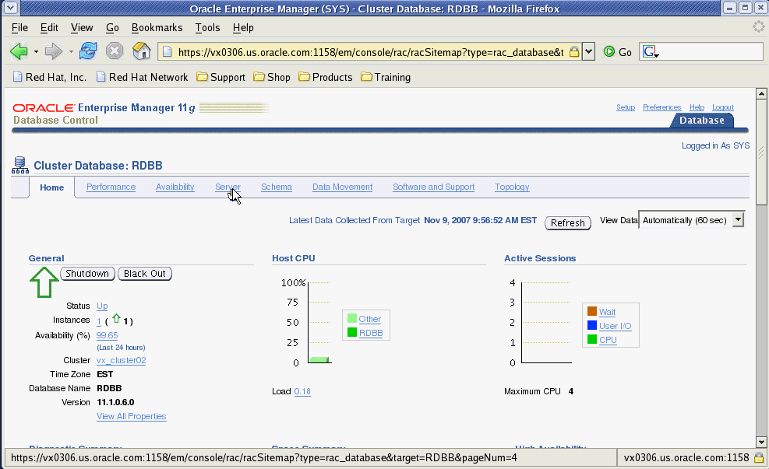
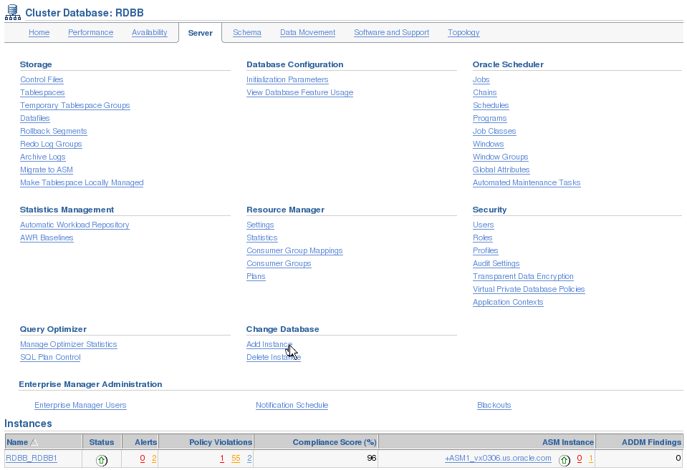
Add an Instance to Your RAC Database Using EM
Notes:
Add an Instance to Your RAC Database Using EM
You can also add a new instance to your RAC database by using the Add Instance Wizard. From the Cluster Database page, click the Server tab. On the Server tabbed page, click Add Instance in the Change Database section of the page.

Slide 19
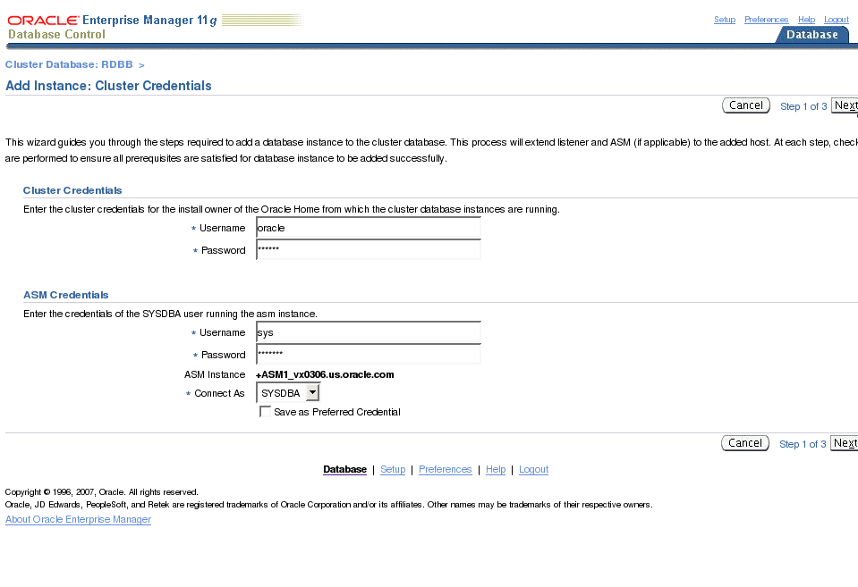
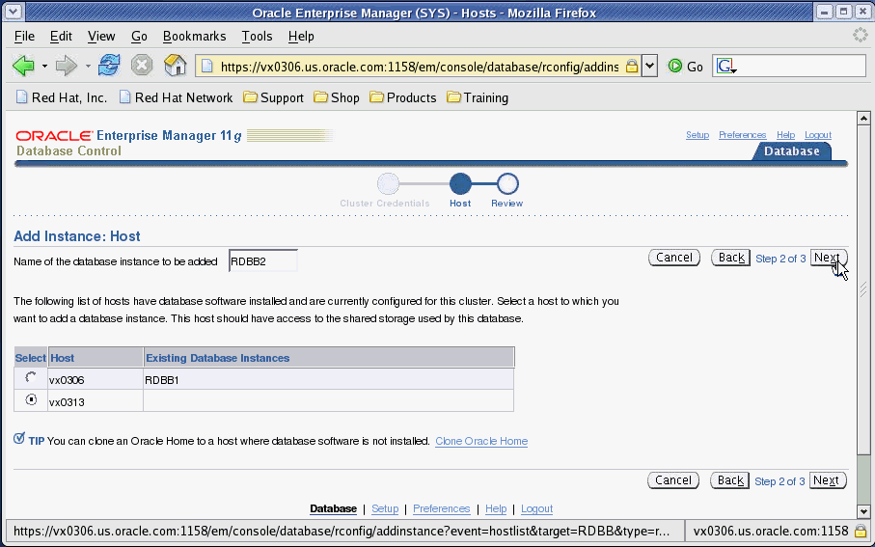
Add an Instance to Your RAC Database Using EM
Notes:
Add an Instance to Your RAC Database Using EM (continued)
You are now on the Cluster Credentials page where you specify the cluster and ASM credentials. The wizard automatically adds the ASM instance before adding the database instance if it is not already created.
When done, click Next to go to the Host page where you specify on which host you want to add the database instance. Select the node in question and click Next.

Slide 20
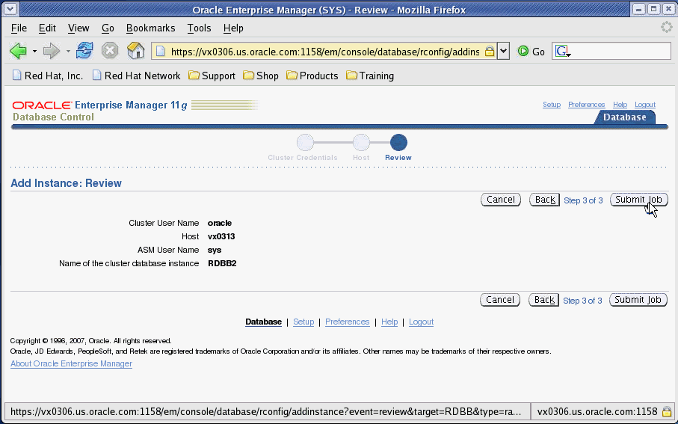


Add an Instance to Your RAC Database Using EM
Notes:
Add an Instance to Your RAC Database Using EM (continued)
On the Review page, click Submit to start the job’s execution.
On the Confirmation page, click “View job” to see the job’s log. After some refreshes of that page, you should get a succeeded status.

Slide 21
Main Steps to Delete a Node from a RAC Cluster
  Delete the instance on the node to be deleted.
  Clean up the ASM instance.
  Remove the listener from the node to be deleted.
  Remove the node from the database.
  Remove the node from ASM.
  Remove ONS configuration from the node to be deleted.
  Remove the node from the clusterware.
[
]
ORACLE_HOME
ORACLE_HOME
ORACLE_HOME
CRS HOME
CRS HOME
CRS HOME
Storage
Notes:
Main Steps to Delete a Node from a RAC Cluster
Note: For all of the add node and delete node procedures for UNIX-based systems, temporary directories such as /tmp, $TEMP, or $TMP, should not be shared directories. If your temporary directories are shared, then set your temporary environment variable, such as $TEMP, to a nonshared location on a local node. In addition, use a directory that exists on all the nodes.

Slide 22




Delete the Instance on the Node to Be Deleted
Notes:
Delete the Instance on the Node to Be Deleted
The first step is to remove the database instance from the node that you want to delete. For that, you use the DBCA from the node you want to delete.
On the Welcome screen, select “Oracle Real Application Clusters database” and click Next.
On the Operations screen, select Instance Management and click Next.
On the Instance Management screen, select “Delete an instance” and click Next.
On the “List of cluster databases” screen, select the RAC database from which you want to delete an instance, enter SYS and its password, and click Next.

Slide 23



Delete the Instance on the Node to Be Deleted
Notes:
Delete the Instance on the Node to Be Deleted (continued)
On the “List of cluster database instances” screen, select the instance that you want to delete and click Finish.
In the Database Configuration Assistant dialog box, click OK to validate your choice.
This triggers the remove instance process. When completed, your instance is removed from your cluster database.

Slide 24



Clean Up the ASM Instance
Notes:
Clean Up the ASM Instance
After your database instance is removed from the node, you can clean up the corresponding ASM instance.
To do this, you need to use SRVCTL to first stop the ASM instance currently running on the node that you want to remove, and then remove that ASM instance from the same node. The two commands are illustrated in the screenshot shown in the slide.
Then, you need to manually remove the initialization parameter file of that ASM instance. As shown in the slide, you can remove files containing the ASM string from the <ASM home>/dbs directory.
After this is done, you can also remove all the log files of that ASM instance. These files are generally located in the $ORACLE_BASE/admin directory.
The last thing you can do is to remove the associated ASM entry from the /etc/oratab file.

Slide 25





Remove the Listener from the Node to Be Deleted
Notes:
Remove the Listener from the Node to Be Deleted
You can now remove the listener from the node that you want to delete. This listener can be from either the ASM home or the database home depending on when it was created.
To remove the listener, you can use NETCA as shown in the slide.
On the Configuration screen, select “Cluster configuration” and click Next.
On the Active Nodes screen, select the node from which you want to remove the listener and click Next.
On the Welcome screen, select “Listener configuration” and click Next.
On the Listener screen, select Delete and click Next.
On the “Select listener” screen, select the corresponding listener, normally called LISTENER, and click Next.
Follow the rest of the screens until the listener is removed from the node.

Slide 26




Remove the Node from the Database
Notes:
Remove the Node from the Database
Before you can use the Oracle Universal Installer to remove the database software installation, you need to update the inventory on the node to be deleted by executing the following command (also shown in the slide):
./runInstaller –updateNodeList ORACLE_HOME=<Database home> "CLUSTER_NODES=<node to be removed>" –local
You need to execute this command from the oui/bin subdirectory in the database home.
After this command is executed, you can start OUI from the same directory, and click “Deinstall products” on the Welcome screen. Then, select the database home and click Remove. This will remove the database home from the node to be deleted.
You now need to update the corresponding inventory on the remaining nodes. You can use the following command from the first node:
./runInstaller –updateNodeList ORACLE_HOME=<Database home> "CLUSTER_NODES=<remaining nodes>"
This command needs to be executed from the oui/bin subdirectory of the database home.

Slide 27




Remove the Node from ASM
Notes:
Remove the Node from ASM
Before you can use the Oracle Universal Installer to remove the ASM software installation, you need to update the inventory on the node to be deleted by executing the following command (also shown in the slide):
./runInstaller –updateNodeList ORACLE_HOME=<ASM home> "CLUSTER_NODES=<node to be removed>" –local
You need to execute this command from the oui/bin subdirectory in the ASM home.
After this command is executed, you can start OUI from the same directory, and click “Deinstall products” on the Welcome screen. Then, select the ASM home and click Remove. This will remove the ASM home from the node to be deleted.
You now need to update the corresponding inventory on the remaining nodes. You can use the following command from the first node:
./runInstaller –updateNodeList ORACLE_HOME=<ASM home> "CLUSTER_NODES=<remaining nodes>"
This command needs to be executed from the oui/bin subdirectory of the ASM home.
Note: This step is not needed if you are not using a separate home directory for ASM.

Slide 28



Remove the Node from the Oracle Clusterware
Notes:
Remove the Node from the Oracle Clusterware
Before you can use OUI to remove the Oracle Clusterware software installation from the node to be deleted, you need to perform the following commands:
The following needs to be done from the first node: <Oracle Clusterware home>/bin/racgons remove_config <Node to be removed>:6251 (Replace port 6251 in the command above with the port number that you get in the remoteport section of the ons.config file found in the <Oracle Clusterware home>/opmn/conf directory.)
The following needs to be done from the node to be removed as the root user: <Oracle Clusterware home>/install/rootdelete.sh
The following needs to be done from the first node as the root user: Determine the node number to be deleted using <Oracle Clusterware home>/bin/olsnodes –n. Then execute <Oracle Clusterware home>/install/rootdeletenode.sh <node name to be deleted>,<node number to be deleted>.
These three steps are illustrated in the slide.

Slide 29




Remove the Node from the Oracle Clusterware
Notes:
Remove the Node from the Oracle Clusterware (continued)
You now need to update the inventory from the node to be deleted by executing: <Oracle Clusterware home>/oui/bin/runInstaller -updateNodeList ORACLE_HOME=<Oracle Clusterware home> "CLUSTER_NODES=<Node to be deleted>" CRS=TRUE -local
When done, run OUI from the same directory and choose “Deinstall products” and remove the Oracle Clusterware installation on the node to be deleted as illustrated in the slide.
You can now update the inventory from the first node by executing the following command: <Oracle Clusterware home>/oui/bin/runInstaller -updateNodeList ORACLE_HOME=<Oracle Clusterware home> "CLUSTER_NODES=<Remaining nodes>" CRS=TRUE
To verify the removal of the node from the cluster, run the following commands from the first node:
srvctl status nodeapps -n <Deleted node> should get a message saying Invalid node.
crs_stat | grep -i <Deleted node> should not get any output.
olsnodes –n should get all the present nodes list without the deleted node.
Note: You should also remove all corresponding oracle homes after this step.

Slide 30

Node Addition and Deletion and the SYSAUX Tablespace
  The SYSAUX tablespace combines the storage needs for the following tablespaces:
    DRSYS
    CWMLITE
    XDB
    ODM
    OEM-REPO
  Use this formula to size
  the SYSAUX tablespace:
  300M + (250M * number_of_nodes)
Notes:
Node Addition and Deletion and the SYSAUX Tablespace
A new auxiliary, system-managed tablespace called SYSAUX contains performance data and combines content that was stored in different tablespaces (some of which are no longer required) in earlier releases of the Oracle database. This is a required tablespace for which you must plan disk space. The SYSAUX system tablespace now contains the DRSYS (contains data for OracleText), CWMLITE (contains the OLAP schemas), XDB (for XML features), ODM (for Oracle Data Mining), and OEM-REPO tablespaces.
If you add nodes to your RAC database environment, then you may need to increase the size of the SYSAUX tablespace. Conversely, if you remove nodes from your cluster database, then you may be able to reduce the size of your SYSAUX tablespace and thus save valuable disk space. The following is a formula that you can use to properly size the SYSAUX tablespace:
300 megabytes + (250 megabytes * number_of_nodes)
If you apply this formula to a four-node cluster, then you find that the SYSAUX tablespace is sized around 1,300 megabytes as shown below:
300 + (250 * 4) = 1300

Slide 31
Summary
In this lesson, you should have learned how to:
  Add a new node to your cluster database
  Remove a node from your cluster database
Notes:
Oracle Database 11g: RAC Administration 11 - <number>

Slide 32
Practice 11: Overview
This practice covers the following topics:
  Removing the second node of your cluster
  Adding it back again
Notes:
Oracle Database 11g: RAC Administration 11 - <number>
Important Note
You can do this lab following either Practice 11 or Practice 13 (13-1 through 13-14). Practice 11 uses mainly OUI and DBCA. Practice 13 uses mainly Grid Control cloning.
You are strongly advised to follow directly the solution appendix for this lab.

